Slide 1
WSO2 vs. TIBCO
Business comparison
May 2025

Slide 2
The benefits of switching to WSO2
50%+
increase in developer productivity
40%+
faster time-to-market
50%+
cost savings

Slide 3
The value of WSO2 compared to TIBCO

Slide 4
Capability | WSO2 | TIBCO
Graphical / Low-code Development | ✓ | ✓
Pro-Code Development | ✓ | X
AI-Assisted Development | ✓ | X
100% Free Connectors | ✓ | Some Premium/Paid Connectors
AI Agents | ✓ | X
API Management | ✓ | X (Sold Mashery to Boomi)
Identity & Access Management | ✓ | X
Deployment Options | Private Cloud, iPaaS, On-Prem, Hybrid | Private Cloud, iPaaS, On-Prem (Limited), Hybrid
Architectural Styles | Microservices, ESB | Microservices, ESB
24x7x365 Support | Included | At extra cost
TCO over 3+ years | Low | High
Open Source Software | ✓ | X

Slide 5


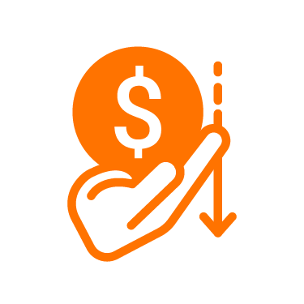





Innovative, future-looking
Flexible deployments
WSO2 product portfolio
Lower TCO
Business + tech collaboration
Easy implementations
100% open source
Upgrade support

Slide 6
Innovative, future-looking product strategy and vision
WSO2 has a clear long-term product strategy focused on building innovative products.
WSO2 | TIBCO
WSO2 has a clear long-term vision and product strategy that is focused on making WSO2 a leader in the integration space with great cloud-native products. This includes: Continuous improvements to the AI-assisted development experience Support to build GenAI apps Support for cloud-native architectures such as microservices, domain-driven architecture, and event-driven architecture Adding an iPaaS to our portfolio | The sentiment is that TIBCO’s innovation has slowed in recent years, and they are perceived as a legacy integration vendor.
 | TIBCO selling Mashery ( API Management) to Boomi has created doubt around their go-forward strategy, and compounded the perception.
 | Mashery customers also face uncertainty as they don’t know what Boomi’s plans for the product are.
 | Most TIBCO customers are using TIBCO BW5 and BW6, which are not cloud-native. BWCE and Flogo are cloud-native, and TIBCO is pushing customers to move to these newer versions.

Slide 7
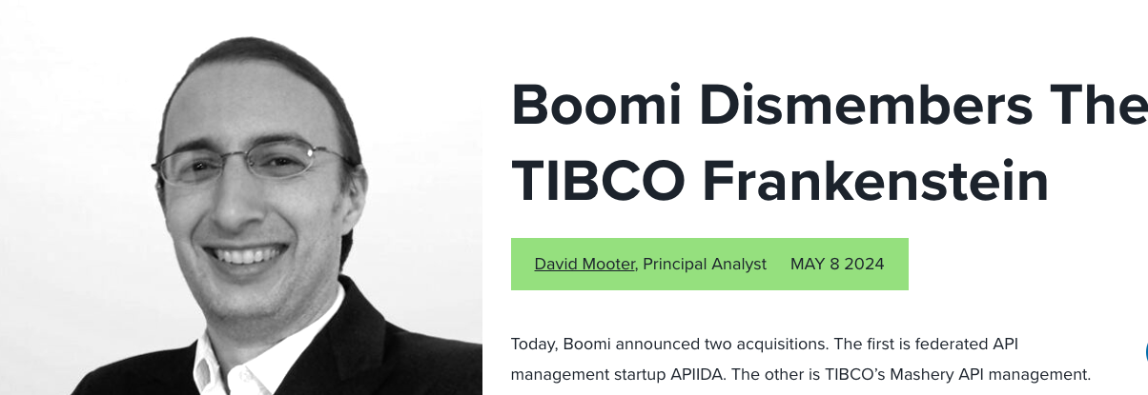
“It is also not surprising that TIBCO sold Mashery. Since being acquired by private equity, TIBCO’s innovation has slowed.”
“TIBCO’s mistake was cobbling together a bunch of unrelated products and not investing in a cohesive user experience. I’ve called it the “TIBCO Frankenstein” to my clients. TIBCO needed to build a unified user experience across its integration products. But with the sale of Mashery, it appears that ship has sailed.”
David Mooter, Principal Analyst, Forrester
Source: https://www.forrester.com/blogs/boomi-dismembers-the-tibco-frankenstein/

Slide 8
100% open source and customizable
WSO2 provides 100% open source software, which is highly customizable.
WSO2 | TIBCO
WSO2’s 100% open source products prevent vendor lock-in, and customers are able to continue to run their integrations on WSO2 products even without a WSO2 subscription. | TIBCO’s proprietary product is only accessible to customers with an active subscriptions, so customers lose the ability run their integrations when the end their TIBCO subscription.
WSO2 software being open source makes it extremely customizable, making it ideal to address any business need regardless of complexity. | TIBCO doesn’t provide access to the product’s source code, and the product can’t be customized as needed.

Slide 9
The WSO2 product portfolio
APIM, Integration, and IAM + WSO2’s Internal Developer Platform.
WSO2 | TIBCO
WSO2 provides industry leading API Management, and Identity and Access Management (IAM) capabilities in addition to Integration capabilities. | TIBCO only provides Integration capabilities, and no longer provides API Management capabilities since selling their API Management business, Mashery, to Boomi. TIBCO also does not have IAM capabilities or an IDP.
WSO2 is also a market creator in the Internal Developer Platform (IDP) space. Customers running WSO2 API Management and Integration as SaaS can easily progress to leveraging the full capabilities of the IDP on the same platform.

Slide 10
Seamless collaboration between business and technical users
WSO2 provides uniquely powerful low-code development with 100% pro-code parity
WSO2 | TIBCO
WSO2 provides an uniquely powerful low-code development approach with 100% pro-code parity on the same platform. Enables business users, integration specialists, and software developers to use a single platform for their integration projects—provides seamless collaboration between business and technical users. | TIBCO doesn’t support pro-code development, so software developers are required to use a different technology for pro-code development. This makes it difficult for teams that consist of both business and technical users to work collaboratively on an integration project.

Slide 11
Flexible deployments
WSO2 provides the options of fully on-premises deployments with no restrictions.
WSO2 | TIBCO
WSO2 supports private cloud, iPaaS, on-premises and hybrid deployments with no restrictions. | TIBCO also provides the same deployment options, but has limitations around fully on-premises deployments.

Slide 12
Lower TCO
WSO2’s TCO is significantly lower. WSO2 is also providing subs at up to 50% off on what you are paying TIBCO today to guarantee a lower TCO.
WSO2 | TIBCO
WSO2 costs are some of the most competitive in the market with no impact on features or performance at large scales. | TIBCO costs are considered to be some of the highest in the market.
WSO2 subscriptions are inclusive of all product features including connectors. | TIBCO charges extra for “premium” connectors.
WSO2 support is included in the subscription. | TIBCO charges extra for 24x7x365 support.
WSO2 pricing model is transparent, and scales with business growth. | TIBCO pricing can see sudden big jumps as usage increases and more features are used.

Slide 13
Learning curve and ease of implementation
WSO2 has a shorter learning curve and is easier to implement.
WSO2 | TIBCO
WSO2’s AI-assisted development experience (e.g. copilot, data mapping, etc.) makes WSO2 a lot easier to learn and use, including for implementing complex integrations. | TIBCO can be complex to learn for new users, especially those who are not familiar with the product concepts and terminologies.
 | Using TIBCO to implement complex integrations requires considerable effort and integration expertise.

Slide 14
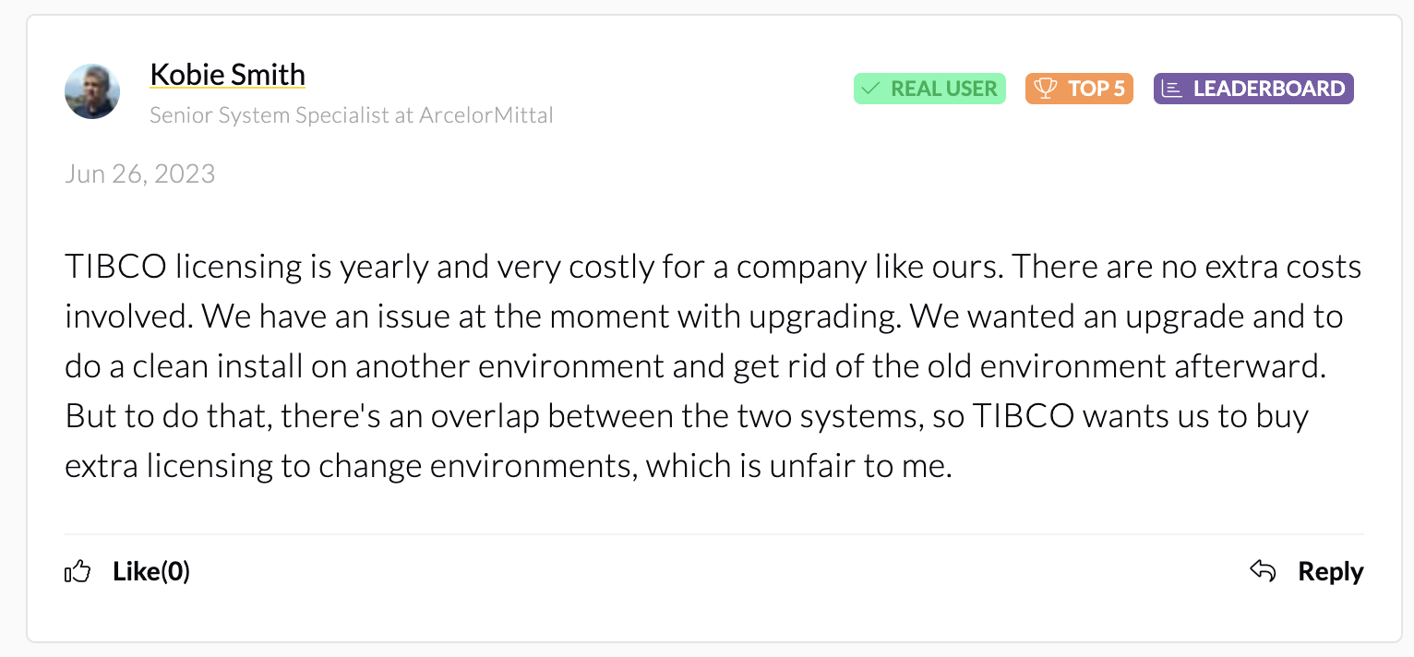
Product upgrade support
TIBCO has issues when upgrading product versions
WSO2 | TIBCO
WSO2 provides a product update process that is available to all customers, making it very easy to migrate between product versions. | TIBCO BusinessWorks 5 is out of support, but upgrading to BusinessWorks 6 is very complex and error prone. There could be increased costs due to migration well.
https://www.peerspot.com/questions/what-is-your-experience-regarding-pricing-and-costs-for-tibco-businessworks

Slide 15
Migrating from TIBCO to WSO2

Slide 16
Migration process
Assessment
Effort Estimation
Costing and Savings
Planning & Migration
Study the existing TIBCO integrations, and availability of resources.
Understand:
# of integrations
Complexity
Types (APIs, event-driven, etc.)
Access to test cases
Use WSO2’s effort estimation guide to calculate the migration effort.
Cost the migration based on the required effort, and create a savings estimate using the savings calculator.
Create and agree on the migration plan, ans success criteria.
Begin migration.
Key considerations
Have a clearly defined migration plan with key milestones, and success criteria.
Identify key stakeholders across all parties, and clearly define roles and responsibilities.

Slide 17
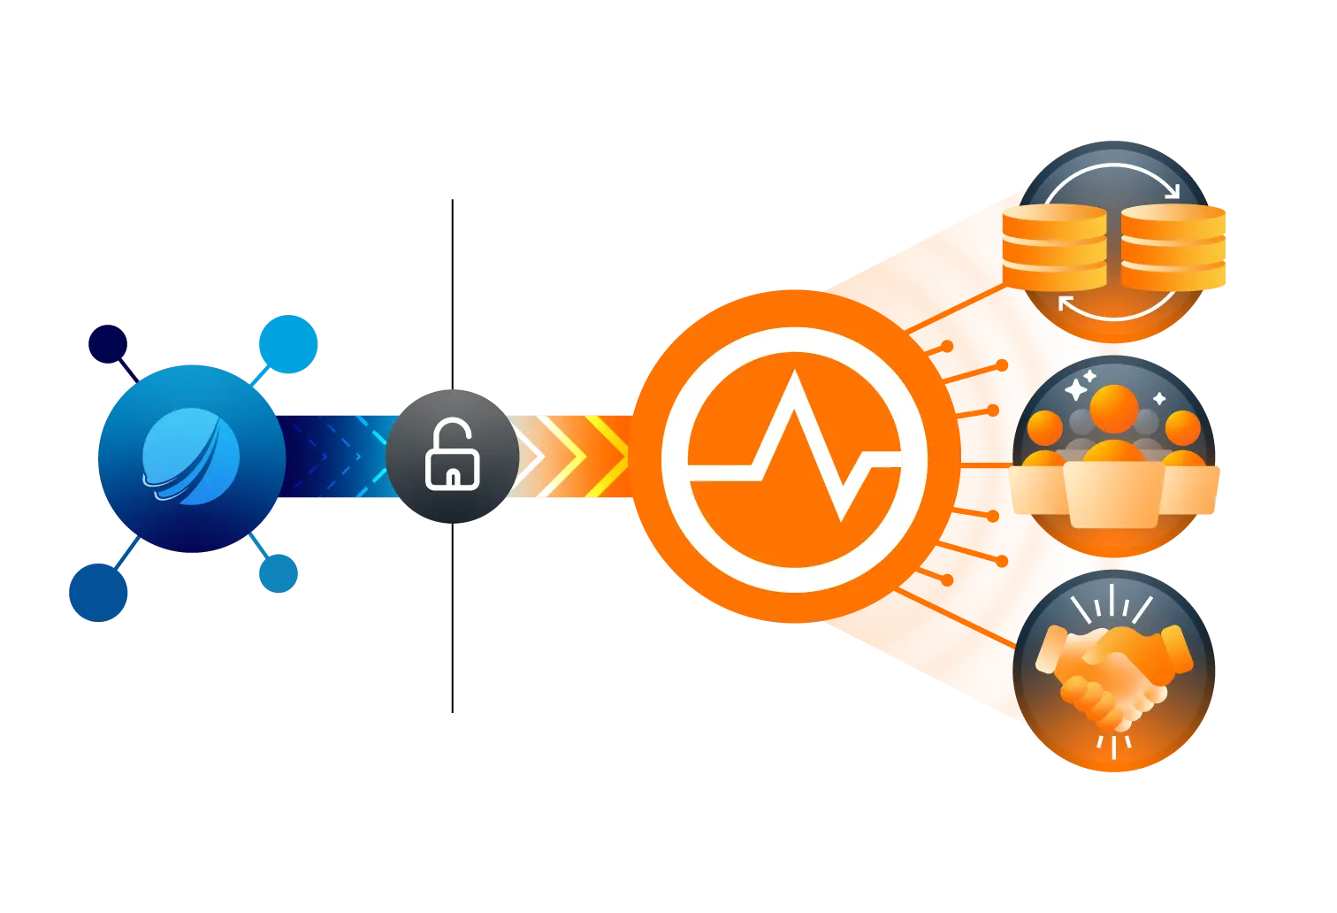
NEW RELEASE: Migration tool to reduce migration time by 50%+
WSO2 has built a tool (available here) to reduce migration time from TIBCO to WSO2.
Supports TIBCO BW5 and BW6.
Reduces migration time by 60% to 90% for most integrations.
A placeholder “unhandled” function with a comment will be generated for any activity that cannot be converted.

Slide 18
Example: Calculating savings by migrating to WSO2
Do not share this slide externally.
Savings should be looked at over a 3+ year period
Savings calculator is available here
Migration effort estimation guide is here
 | Year 1 | Year 2 | Year 3
Annual TIBCO Subscription Cost | $1,000,000 | $1,300,000 | $1,500,000
WSO2 Subscription Discount | 50% | NA | NA
Annual WSO2 Subscription Cost | $500,000 | $550,000 | $605,000
Migration Cost | $1,000,000 | $0 | $0
Savings | -$500,000 | $750,000 | $895,000
Total Savings Over 3 Years |  |  | $1,145,000

Slide 19
Case studies

Slide 20

A major Malaysian telco
Photo by Chris Linnett on Unsplash
Problem:
Complex middleware landscape that was made up of multiple platforms, including TIBCO (and MuleSoft, webMethods, and Oracle)
The legacy architecture struggled to handle increasing tx volumes and peak loads, leading to performance degradation and service disruptions
Lengthy development and deployment cycles hindered their ability to quickly introduce new products and services, impacting competitiveness
The infrastructure complexity required significant resources for support and maintenance, impacting operational efficiency and increasing costs
Consolidating the middleware platform onto WSO2 resulted in…
30% improvement in transaction performance ensuring seamless operations during peak usage, enhanced service quality, and faster response times
40% reduction in interfaces by consolidating multiple platforms into a unified solution has led to streamlined maintenance, reduced operational costs, and improved overall system efficiency
40% lower maintenance costs with WSO2 compared to prior vendors
A scalable and adaptable infrastructure to support future growth and evolving business needs
“We’re committed to providing the best possible customer experience. By leveraging WSO2’s technology, we’ve been able to significantly improve the performance and reliability of our systems, resulting in faster response times and fewer service disruptions”
‹#›

Slide 21

A local government body responsible for the transport system in a major UK city
Photo by Tomas Anton Escobar on Unsplash
Previous state:
They previously used TIBCO Business Works for integration transformation and composition, and TIBCO Enterprise Messaging System (EMS) for pub-sub asynchronous messaging
They were using TIBCO to run a process critical application—the continuous, stable operation of it was crucial for the business
Current state
They moved this application from TIBCO to WSO2 Enterprise Integrator (now WSO2 Integrator: MI) and WSO2 Message Broker (proposed to move to Amazon SQS)
They have expanded to use WSO2 integration technology in several other projects too
WSO2 was selected because of our open source products, cost effectiveness of the implementation, and the seamless integrated platform that we provide
Their road and rail management systems now rely on WSO2 to gain better insights to coordinate maintenance work, and minimize congestion while adhering to inspection and compliance requirements
WSO2 has helped them better identify patterns and trends of maintenance that resulted in better commuter experience and intelligent insights
WSO2 is a good company to work with, they understand things from a customer’s point of view, and they deliver from a business perspective. In our case, it was to transform the way we deliver operational technology.”
‹#›
Notes:
Photo by Tomas Anton Escobar on Unsplash

Slide 22

A major South African bank
Photo by Etienne Martin on Unsplash
Problem:
The bank’s TIBCO based integration layer was causing long lead times, and the Risk Division wanted a flexible integration solution for accurate and reliable customer risk and sanction list screening and onboarding
They also needed to add a measure of intelligence to the screening solution, which was not possible on TIBCO as it was a data pass-through layer.
They required a solution that permitted writing additional business logic, and required the solution to be within the Risk Division’s control
The infrastructure complexity required significant resources for support and maintenance, impacting operational efficiency and increasing costs
Switching from TIBCO to WSO2:
The bank selected WSO2 due to cost-effectiveness, quick deployment time, and the ease of configuration, and GTM took just 3 months from solution conceptualization to production
The new solution has significantly decreased delivery time, resulted in fewer errors, and led to no downtime issues.
WSO2 has proven successful in managing workload spikes, enabling the Risk Division to perform quick deployments and configuration in the event of ad-hoc changes.
9M active customer screenings per day
250+ services and 20+ systems connected for risk profiling
‹#›

Slide 23
FAQs

Slide 24
FAQs and responses
Question | Response
We have been using TIBCO for many years, and they provide connectors to all our legacy systems, including Mainframes. Can WSO2 provide us with the same level of connectors for legacy systems? | WSO2 also has out-of-the-box connectors for many legacy systems. WSO2 also works with all our customers to build connectors for any systems to which we don’t have existing connectors—a service we provide at no extra cost.
I am locked into my TIBCO contract for several more years, and there is no cancellation option. What do I do? | You can start by using WSO2 for any new Integration project in your company, cancel your TIBCO contract at your next renewal, and migrate completely to WSO2 at that point in time. It is cheaper to use WSO2 for your new projects than it would be to expand your TIBCO deployment. This also gives you the opportunity to compare the benefits of WSO2 vs. TIBCO over a period of time.

Slide 25
FAQs
Question | Response
How much effort will it take to migrate from TIBCO to WSO2? | It depends on the complexity of your deployment, and we can share an estimate once we understand the specifics of your existing deployment.
Migrating is expensive. How am I going to lower my TCO if I have to spend on migrating to WSO2? | The migration costs are most likely to be incurred in year 1. Therefore, you need to look at how much you will save over a 3+ year period by reducing your TIBCO subscription costs, not just over 1 year. WSO2 can also help you structure your investment in a cost-effective, flexible manner that helps you realize your ROI faster.

Slide 26
FAQs and responses
Question | Response
TIBCO is ranked on the Gartner MQ and Forrester Wave for iPaaS, but WSO2 is not on these rankings. Does that mean that TIBCO is better? | No, it does not. WSO2’s iPaaS capabilities are new, which is why we do not qualify for these rankings, but Choreo, our Internal Developer Platform with integration capabilities received an honourable mention in the 2024 Gartner MQ for iPaaS. Additionally, WSO2 API Manager, which bundles our integration capabilities is ranked in the Gartner MQ and Forrester Waves for API Management. It also scored 3.8/5 for API-based integration (second only to IBM) in the 2024 Gartner Critical Capabilities report for API Management.
How can I be sure that WSO2 provides the same level of capabilities as TIBCO? | WSO2 provides proven technology that is used by 700+ customers globally. We would be happy to address any concerns you have by taking a sample use case, and implementing a PoC if required.

Slide 28
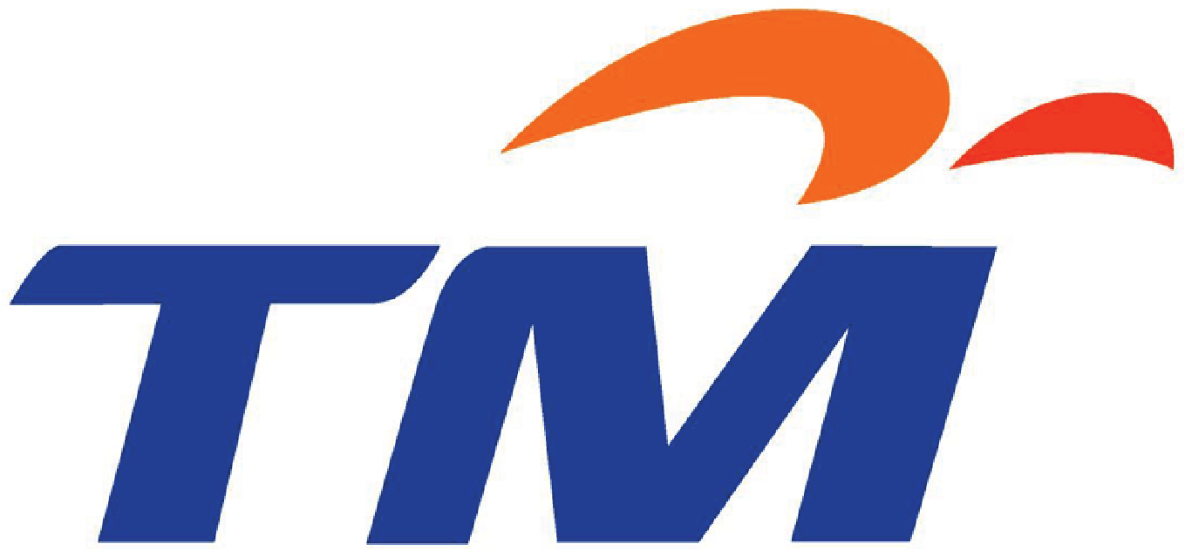

Telekom Malaysia (Malaysia)
Do not share this slide externally.
Problem:
Complex middleware landscape that was made up of multiple platforms, including TIBCO (and MuleSoft, webMethods, and Oracle)
The legacy architecture struggled to handle increasing tx volumes and peak loads, leading to performance degradation and service disruptions
Lengthy development and deployment cycles hindered their ability to quickly introduce new products and services, impacting competitiveness
The infrastructure complexity required significant resources for support and maintenance, impacting operational efficiency and increasing costs
Consolidating the middleware platform onto WSO2 resulted in…
30% improvement in transaction performance ensuring seamless operations during peak usage, enhanced service quality, and faster response times
40% reduction in interfaces by consolidating multiple platforms into a unified solution has led to streamlined maintenance, reduced operational costs, and improved overall system efficiency
40% lower maintenance costs with WSO2 compared to prior vendors
A scalable and adaptable infrastructure to support future growth and evolving business needs
“We’re committed to providing the best possible customer experience. By leveraging WSO2’s technology, we’ve been able to significantly improve the performance and reliability of our systems, resulting in faster response times and fewer service disruptions”
‹#›

Slide 29


Transport for London (UK)
Do not share this slide externally.
Previous state:
Transport for London (TfL) previously used TIBCO Business Works for integration transformation and composition, and TIBCO Enterprise Messaging System (EMS) for pub-sub asynchronous messaging
TfL was using TIBCO to run their Train Data System (TDS) platform - a process critical application and the continuous, stable operation of it is crucial for the business
Current state
TfL moved TDS from TIBCO to WSO2 Enterprise Integrator (now Micro Integrator) and WSO2 Message Broker (proposed to move to Amazon SQS)
TfL now uses WSO2 integration technology in their LondonWorks and Railsys projects in addition to TDS
TfL selected WSO2 because of our open source products, cost effectiveness of the implementation, and the seamless integrated platform that we provide
TfL’s road and rail management systems now rely on WSO2 to gain better insights to coordinate maintenance work, and minimize congestion while adhering to inspection and compliance requirements
WSO2 has helped TfL better identify patterns and trends of maintenance that resulted in better commuter experience and intelligent insights
WSO2 is a good company to work with, they understand things from a customer’s point of view, and they deliver from a business perspective. In our case, it was to transform the way we deliver operational technology.”
‹#›
Notes:
Transport for London (TfL) keeps 8 million people moving around the metropolis with the help of WSO2. London’s new road management system relies on WSO2’s API management, integration, identity and access management, and analytics products for the intelligent work needed. These products are deployed on a private cloud managed by WSO2.
The starting point – LondonWorks, a registry of all road works and street related events, both planned and current, in the Greater London area. LondonWorks is used to assess road networks, coordinate the various road works to minimize congestion and for inspection, compliance, and monitoring. Maps and forms of type data have been integrated to allow entry of incidents into the system and their identification on the map.
TfL is now in a position to gain better insights using WSO2, which will help them in improving commuter experiences.
https://wso2.com/library/conference/2017/11/wso2con-eu-2017-transforming-the-way-we-deliver-operational-technology/

Slide 30
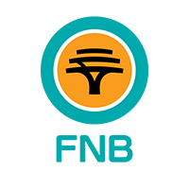

First National Bank (South Africa)
Do not share this slide externally.
Problem:
The bank’s TIBCO based integration layer was causing long lead times, and the Risk Division wanted a flexible integration solution for accurate and reliable customer risk and sanction list screening and onboarding
They also needed to add a measure of intelligence to the screening solution, which was not possible on TIBCO as it was a data pass-through layer.
They required a solution that permitted writing additional business logic, and required the solution to be within the Risk Division’s control
The infrastructure complexity required significant resources for support and maintenance, impacting operational efficiency and increasing costs
Switching from TIBCO to WSO2:
FNB selected WSO2 due to cost-effectiveness, quick deployment time, and the ease of configuration, and GTM took just 3 months from solution conceptualization to production
The new solution has significantly decreased delivery time, resulted in fewer errors, and led to no downtime issues.
WSO2 has proven successful in managing workload spikes, enabling the Risk Division to perform quick deployments and configuration in the event of ad-hoc changes.
9M active customer screenings per day
250+ services and 20+ systems connected for risk profiling
‹#›

